Slide 1
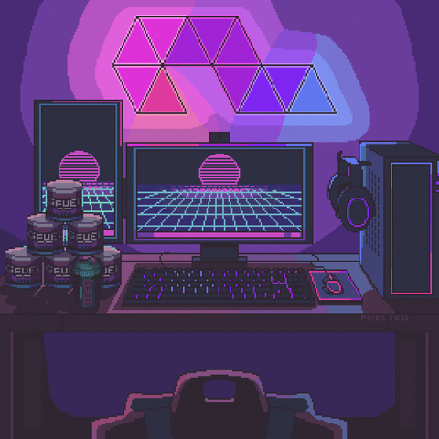
What Is Information Technology? A Beginner’s Guide to the World of IT.
The simplest definition of information technology is the widespread application of technology to organizational or business challenges.
Members of an IT department collaborate with one another to address both major and minor technological issues, regardless of their specific IT roles. The importance of information technology in today's wireless society cannot be overstated.
Information technology (IT) is basically synonymous with the people you call when you need help with a computer issue. While that view of information technology isn't totally wrong, it drastically understates the scope of this critical career field.

Slide 2
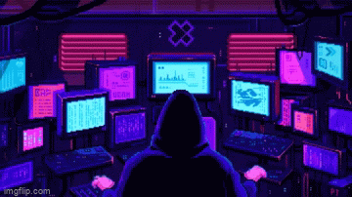
What is information technology and what does it encompass?
IT governance:
The simplest definition of information technology is the widespread application of technology to organizational or business challenges.
Members of an IT department collaborate with one another to address both major and minor technological issues, regardless of their specific IT roles. The importance of information technology in today's wireless society cannot be overstated.
This refers to the combination of policies and processes that ensure IT systems are effectively run and in alignment with the organization's needs.

Slide 3
IT governance:
This is a catchall category for the daily work of an IT department. This includes providing tech support, network maintenance, communication protocols, security testing and device management duties.
This refers to the combination of policies and processes that ensure IT systems are effectively run and in alignment with the organization's needs.
IT operations:

Slide 4
IT operations:
This is a catchall category for the daily work of an IT department. This includes providing tech support, network maintenance, communication protocols, security testing and device management duties.

Slide 5
Hardware and Software Infastructure
This focus area refers to all the physical components of IT infrastructure. This pillar of IT includes the setup and maintenance of equipment like routers, servers, phone systems and inventory control - including individual devices like laptops.

Slide 6
IT operations:
This is a catchall category for the daily work of an IT department. This includes providing tech support, network maintenance, communication protocols, security testing and device management duties.

Slide 7
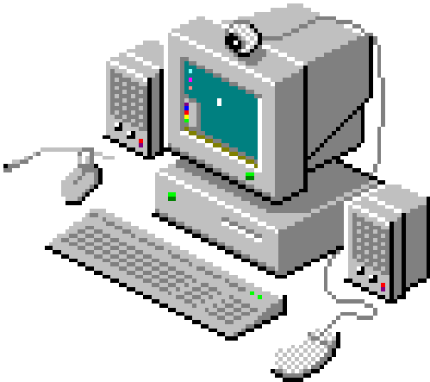
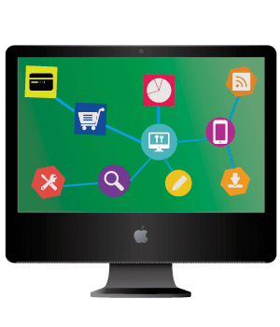
Hardware vs. Software
Hardware includes all the physical parts of a computer system. This includes hardware installed inside the computer like the motherboard, central processing unit and hard drive. Hardware also describes components that can be connected to the outside of a computer like a keyboard, mouse and printer.
Unlike hardware, software is not something you can physically change. Software encompasses all the data, application and programs stored electronically, like an operating system or a video-editing tool.

Slide 8
Hardware vs. Software
Hardware includes all the physical parts of a computer system. This includes hardware installed inside the computer like the motherboard, central processing unit and hard drive. Hardware also describes components that can be connected to the outside of a computer like a keyboard, mouse and printer.
Unlike hardware, software is not something you can physically change. Software encompasses all the data, application and programs stored electronically, like an operating system or a video-editing tool.

Slide 9
Hardware vs. Software
Hardware includes all the physical parts of a computer system. This includes hardware installed inside the computer like the motherboard, central processing unit and hard drive. Hardware also describes components that can be connected to the outside of a computer like a keyboard, mouse and printer.
Unlike hardware, software is not something you can physically change. Software encompasses all the data, application and programs stored electronically, like an operating system or a video-editing tool.

